Slide 1



Slide 2

THE ART OF EXCLUSIVE AND LIMITLESS TRAVELING

Slide 3

Born at the crossroads of wanderlust and world‑class entertainment. We design
seamless journeys to the globe’s most electrifying destinations. Our white‑glove
concierge unlocks private villas, tailored transport, and coveted VIP access,
transforming simple travel into an all‑access experience.
From doorstep to encore, we orchestrate every detail so you can savor the luxury,
exclusivity, and memories that outlast for a lifetime.

Slide 4

WHITE GLOVE CONCIERGE
Our bespoke concierge service is
designed to elevate every moment of
your journey. From securing private villas
and luxury accommodations, arranging
personalized ground transportation and
getting you into the most exciting events,
we ensure your experience is seamless from start to finish

Slide 5

JUST ASK AND OUR CONCIERGE TEAM WILL MAKE SURE YOU GOT EVERYTHING YOU NEED.
Villas & Apartments
Luxury Vehicles
Boats & Yatchs
Ground Transportation
VIP Event Access
Night Club Access

Slide 6
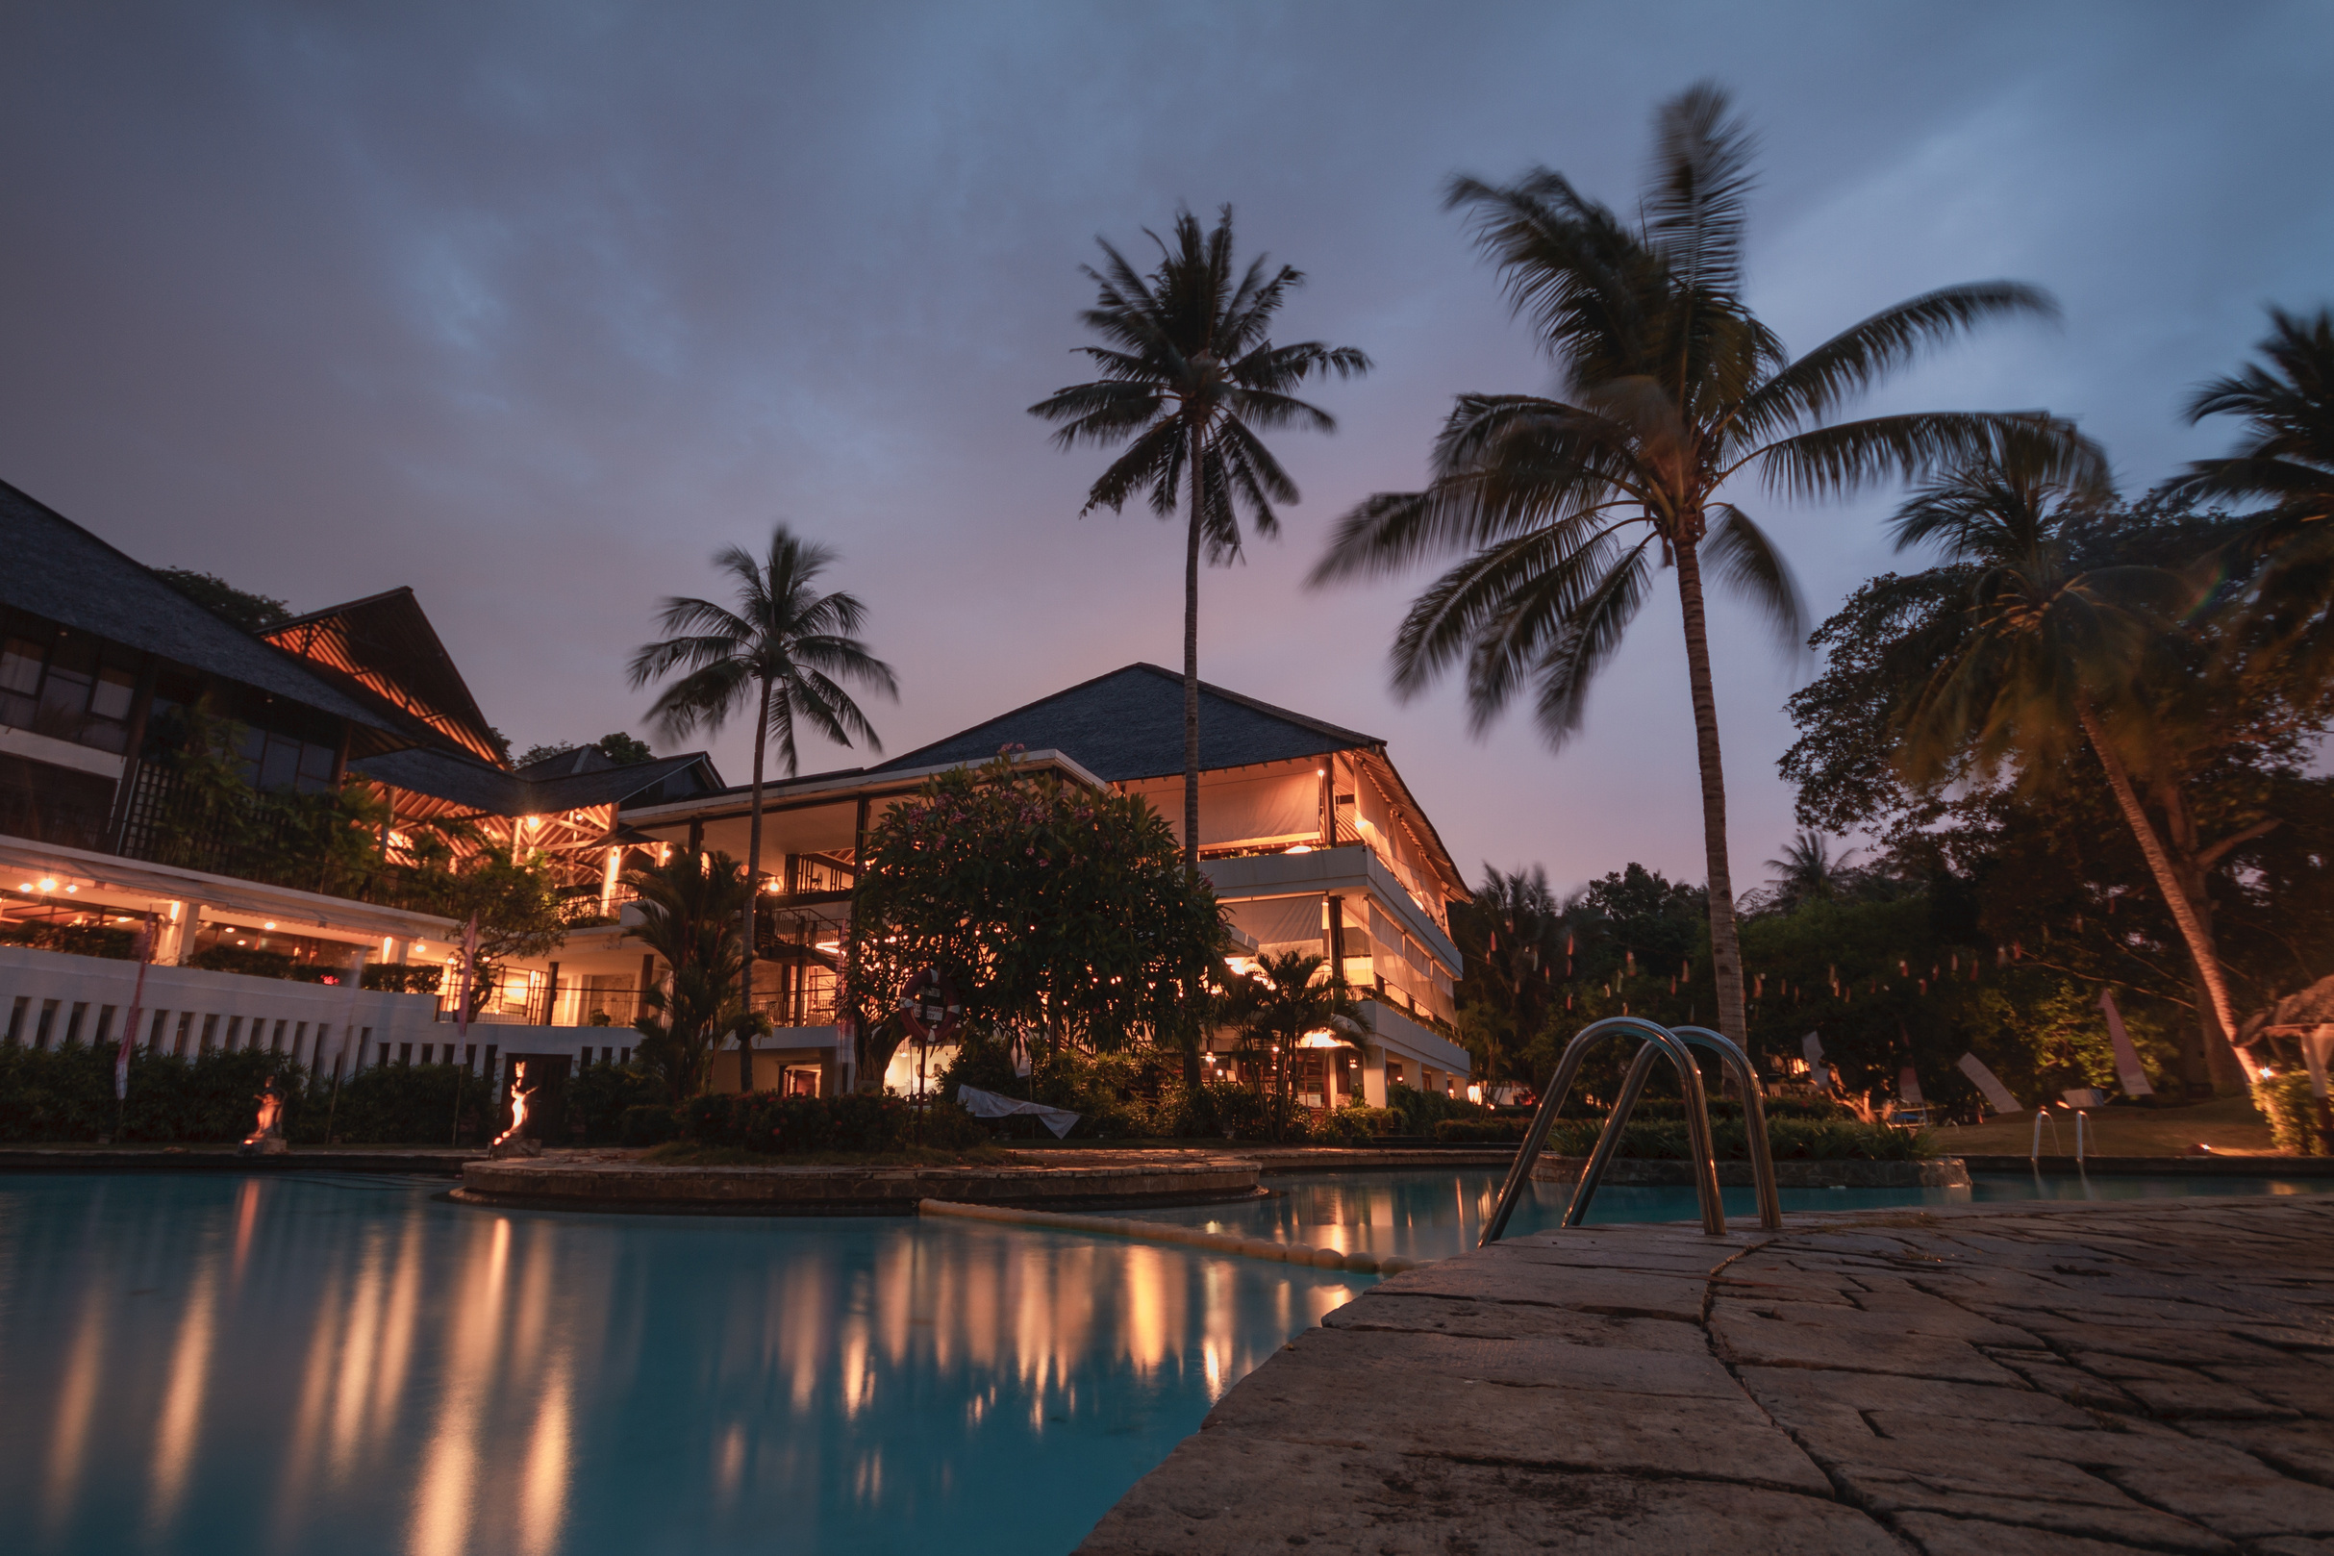

Slide 7

THESE ARE SOME OF THE HIGH PROFILE EVENTS IN THE WORLD THAT
Go Access will help you score
Zamna
edc mexico
World cup 2026
Mexico F1 championship
Day zero
Vive latino

Slide 8

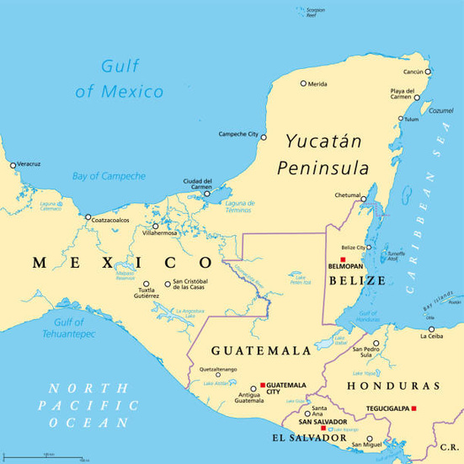
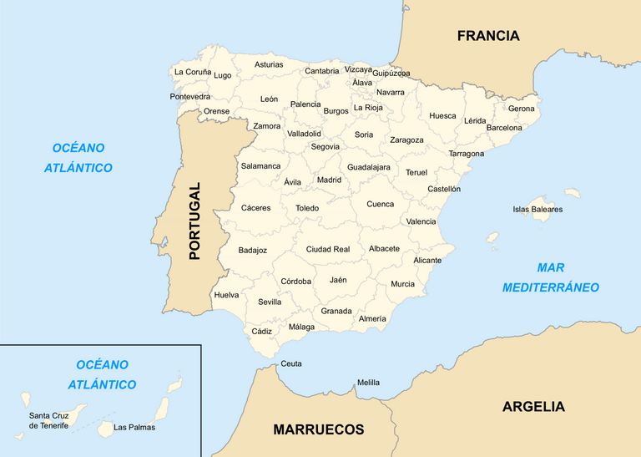
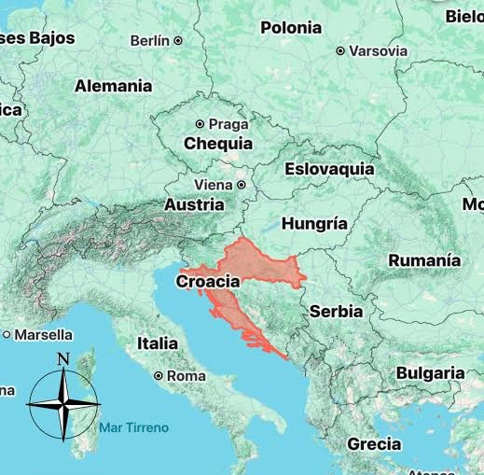
THERE ARE NO LIMITS TO WHAT WE CAN DO, BUT WE TAKE
pride in truly knowing each destination to craft the
best experiences for you.

Slide 9




WE MAKE SURE YOU FIND A WAY TO GO
Ecommerce Payments
Multi Currency Deposits
Special Offers

Slide 10





100% PERSONALIZED SERVICE
Your time matters to us. Every journey we create is tailor-made for
you — shaped by who you are and what you seek. We take the
time to understand your desires, because for us, every trip is a
memory in the making, and every traveler is truly one of a kind.
GET A QUOTE FROM US AND START PLANNING YOUR NEXT
journey.
+52 33 2630 8755
hello@goaccess.live
@goaccess.live
www.goaccess.live

Slide 11

WITH LOVE
-GO ACCESS

